Slide 1
Parting Reflections
American National Government PSC101/Spring 2013

Slide 2
Engaging Democracy
Paul, the Ephesians, and the Cross of Christ

Slide 3
Only from the perspective of the cross, shattering as it was to Jesus’ followers then as it should be now,
can any view of politics
…claim to be Christian.
--N.T. Wright,
The New Testament and the State

Slide 4
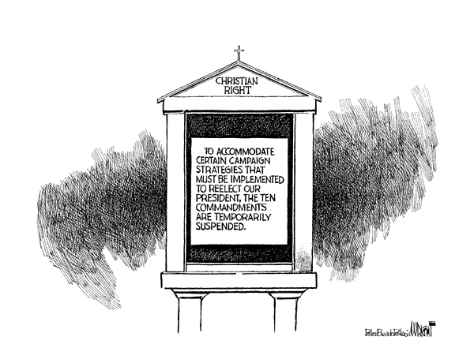

Slide 5
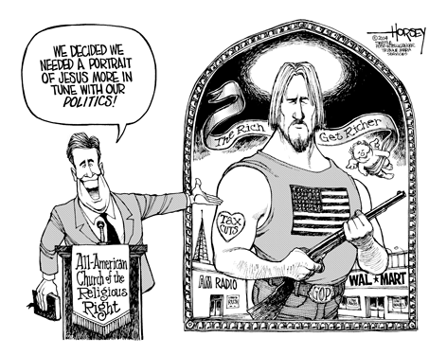

Slide 7
“Write this to Ephesus…I see what you’ve done, your hard work, your refusal to quit. I know you can’t stomach evil, that you weed out apostolic pretenders. I know your persistence, your courage in my cause, that you never wear out. But you walked away from your first love—why? What’s going on with you, anyway? Do you have any idea how far you’ve fallen? Turn back! Recover your dear early love…”
--Revelation 2:1-5 from The Message//Remix

Slide 8
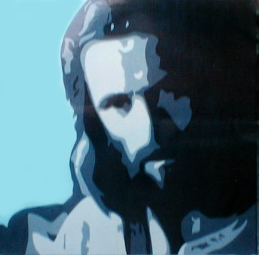
Love Jesus.
Love People.
Nothing Else Matters.

Slide 9
The cross is the surest, truest and deepest window on the very heart and character of the living and loving God…
--N.T. Wright,
The Challenge of Jesus

Slide 10
Political participation…
they should know we are Christians by our love, mirrored as it ought to be in the politics of the cross.

